Slide 1

Spain electricity shortfall challenge
Innovations designed for a better living

Slide 2

Get to know us
Team JS3
Company Name ( Pro-Tech )
Team members :
Mlondi Shoba
Mapula Maponya
Samuel Mnisi
Patrick Mafokwane
Mandlenkosi Ngidi
Nokubongwa Ndlela
Nkoka Khosa

Slide 3

Understanding the problem
The supply of electricity plays a large role in the livelihood of citizens in a country.
Therefore there's a need to keep the lights on in order to maintain and improve the standard of living by investing in electricity infrastructure.
In recent years, there has been evidence that the use of purely non-renewable sources is not sustainable.
The government of Spain is considering an expansion of its renewable energy resource infrastructure investments.
They require information on the trends and patterns of the country's renewable sources and fossil fuel energy generation

Slide 4

Project objective
Model the shortfall between the energy generated by means of fossil fuels and various renewable sources - for the country of Spain.
The daily shortfall, which will be referred to as the target variable, will be modelled as a function of various city-specific weather features such as `pressure`, `wind speed`, `humidity`, etc.

Slide 5
Data Exploration & EDA
1
2
Columns
46 Numerical Data Type Columns
3 Categorical Data Type Columns
column with missing values is the “Valencia_pressure” column
Observations
3
4
Load shortfall (3h)
Using Correlation heatmap
Target variable
Feature correlation

Slide 6
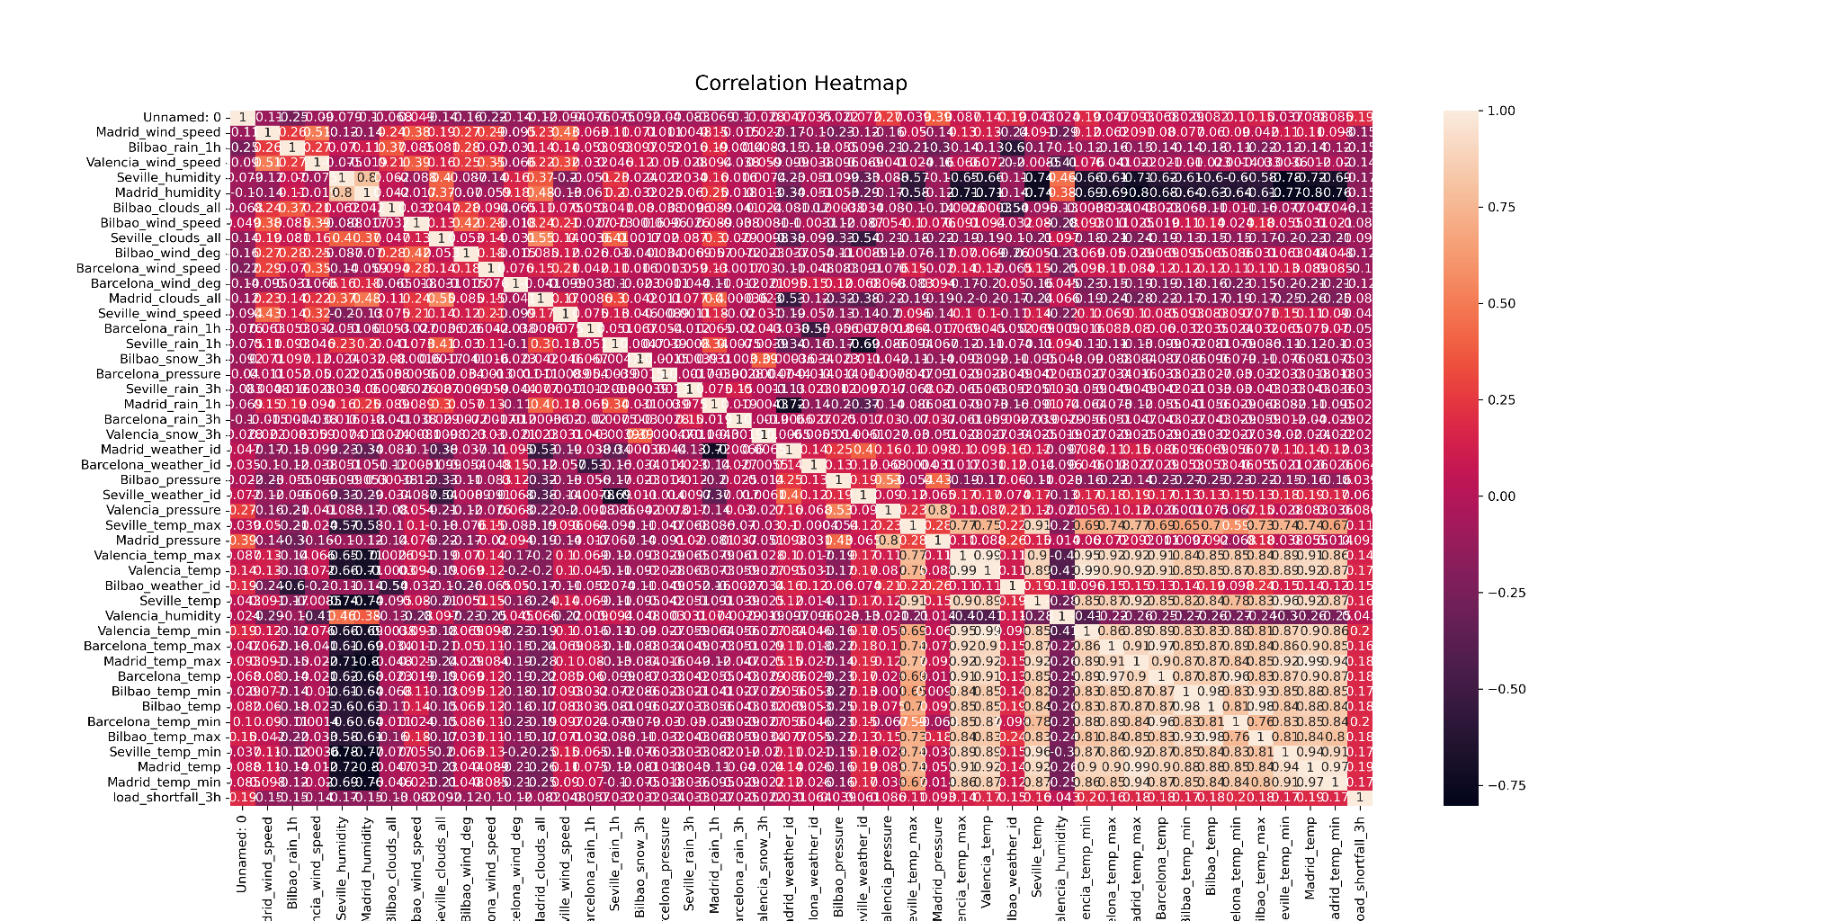
Data Exploration & EDA
There is high correlation between some columns, this will cause problems in our modelling stage, therefore will be dealt with in the Data engineering stage

Slide 7
Irregularities
1
1
3
3
Boxplot displaying outliers when looking at feature distribution.
High correlation detected in some features. (multicollinearity), causing overfitting in models.
2
4
2
4
Extreme values in skewness
Features with no values or nulls and incorrect data types.

Slide 8
Data engineering
datam
Data check
1
We had 48 column to work with, excluding the removed missing values column.
Change data type
(conversion).
2
Changed 3 features from object to numeric.
Convert the time type from an object to a datetime format and create new features from it.
Engineering existing
features
3
standardization method.
4
Saving standardized feature into new variable. And the new features derived from time were added to improve the model performance

Slide 9

Supervised machine learning approaches
3 Models were compared
Linear regression model
Decision tree model
Random forest model

Slide 10
Model performance
Model performance of all 3 models with the time feature included but splitted into sections
Linear regression model
Decision tree model
Random forest model
RMSE | 5577.79
RMSE | 2981.05
RMSE | 7392.02
R2 score | -0.12
R2 score | 0.68
R2 score | -0.96
MSE | 3.11e+07
MSE | 8.89e+06
MSE | 5.46e+07

Slide 11
Conclusion
Our chosen model is the Random forest.
Reason being:
Best RMSE,MAE,R-squared scores
Robust to outliers present in data
Generalise better to unseen data

